Slide 1
Hypertonic Saline Versus Mannitol For Treatment of Elevated Intracranial Pressure in Traumatic Brain Injury
Erin Beauclair, Pharm.D. and Elli Emerson, Pharm.D.
Essentia Health PGY-1 Acute Care Pharmacy Residents
October 27th, 2022

Slide 2
Members of the Debate
Debate Coordinator: Jenni Catlin, Pharm.D., BCPS, BCCCP - Sanford Health
Judge: Saidee Oberlander, Pharm.D., BCPS – Essentia Health
Moderator: Bernie Behm, Pharm.D., BCPS – Essentia Health
Affirmative: Elli Emerson, Pharm.D. – Essentia Health
Negative: Erin Beauclair, Pharm.D. – Essentia Health

Slide 3
Faculty disclosures
The presenters have no relevant financial relationships with ineligible companies to disclose.

Slide 4
Learning Objectives for the NDSHP Drug Therapy CE Series
1. Describe how the presented topic impacts patient outcomes
2. Review evidence-based guidelines and best practices described
3. Identify two clinical endpoints of the presented topic
4. Recommend therapeutic means to achieve clinical endpoints

Slide 5
Abbreviations
BBB = blood-brain-barrier
CI = confidence interval
CSF = cerebral spinal fluid
CPP = cerebral perfusion pressure
GCS = Glasgow Coma Scale
HTS = hypertonic saline
ICP = intracranial pressure
IRAE = infusion related adverse event
MD = mean difference
OR = odds ratio
RCT = randomized clinical trial
TBI = traumatic brain injury

Slide 6
Background

Slide 7
Epidemiology
Prevalence
Risk Factors
For poor outcomes
Causes
Falls
Vehicle collisions
Sports injuries
Violence
Combat (e.g., explosive blasts)
In 2019:
Hospitalizations: 223,135
In 2020:
Deaths: 64,362
Male
Age >75
Racial and ethnic minorities
Military members
Incarcerated persons
Intimate partner violence
People living in rural areas
Homelessness
Notes:
~30% mortality

Slide 8
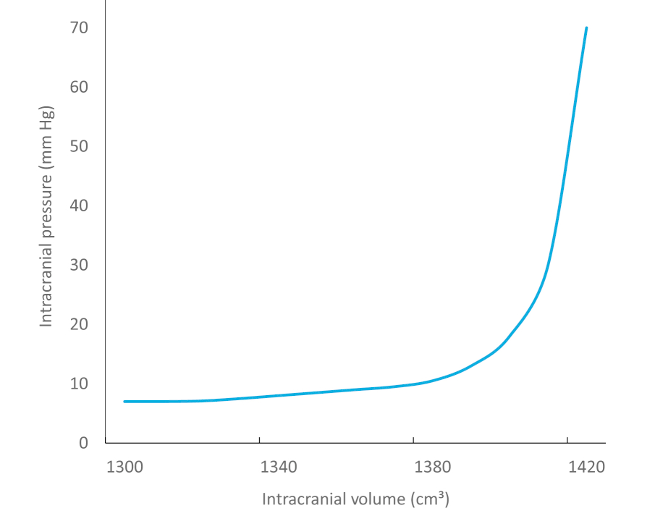
Pathophysiology – Monro-KellIe Hypothesis
Postulates:
The cranial vault is a rigid compartment
The sum of volumes of brain tissue, CSF, and intracranial blood is constant
Any increase in one component should cause a proportional decrease in the other components
ICP increases exponentially once compensatory mechanisms are exhausted
Ultimately leads to decreased perfusion (oxygenation) to the brain
Compensatory mechanisms exhausted
Notes:
Component volume percentages:
Brain ~80%
CSF ~10%
Intracranial Blood ~10%

Slide 9
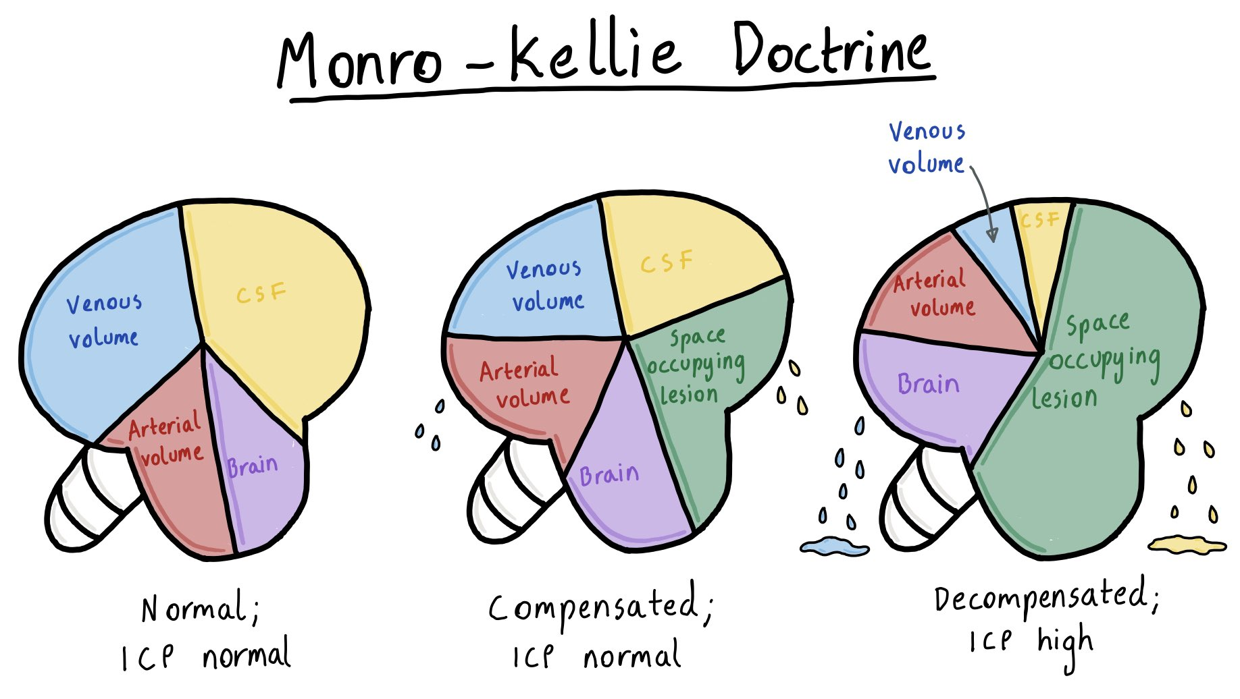
Pathophysiology – Monro-KellIe Hypothesis
CPP = MAP - ICP
Notes:
Compensatory mechanisms:
If there is an addition of a mass (e.g., hematoma, cerebral edema, tumor) equal volumes of venous and CSF volume will decrease to maintain normal ICP and to protect brain matter. However, when these mechanisms are exhausted, the mass will be able to swell in volume – causing an exponential increase in ICP. When ICP elevates, CPP decreases, thus causing deoxygenation and brain ischemia and infarction may occur due to this mechanism (as well as being "squished")

Slide 10
Pathophysiology – Monro-KellIe Hypothesis
Brain inflammation and edema (cerebral vasodilation)
ICP Elevation
Brain ischemia
Cerebral herniation
Death
Deoxygenation
Decreased CPP
Brain hypoperfusion
Notes:
Proverbial death spiral of elevated ICP:
Brain ischemia – brain is being "squished" and cell death occurs due to lack of oxygenation and energy (glucose) supply
Cerebral herniation – this is when brain tissue translocates. This may be towards the largest hole in the skull – the foramen magnum. If this occurs and pressure is put on the brainstem – essential functions (e.g., respiratory drive, heart functions) may cease and death occurs.

Slide 11
Other Consequences of Uncontrolled ICP
Mood and Behavioral Changes
Seizures
Optic Neuropathy
Loss of Vision
Persistent Headaches or Migraines
Loss of Motor Function

Slide 12
Goals of Care
Maintain adequate oxygen delivery
Avoid further injury
Prevent cerebral herniation
CPP used as surrogate to measure global cerebral blood flow:
CPP = MAP – ICP
Goal ICP: <20-22 mmHg
Goal CPP: 60-70 mmHg
Therapeutic hypothermia or maintain normothermia
30-degree elevation of skull
Brain tissue moves into adjacent space (especially foramen magnum)
Cook, 2020
Carney, 2016
Notes:
CPP 60-70 mmHg shown to be associated with reduction in 2-week mortality

Slide 13
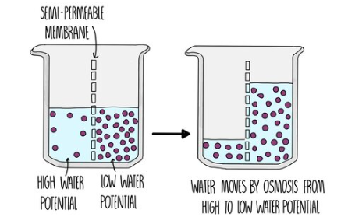
Osmotherapy- mechanism of action
Key concepts:
Osmolarity
Concentration of a solution expressed as the total number of solute particles per unit of volume
Osmosis
Movement of water across a semipermeable membrane from an area of low solute concentration to an area of higher solute concentration; creates concentration gradient
Notes:
-CSF drainage, decompressive craniectomy

Slide 14
Osmotherapy- mechanism of action
Hypertonic solution enters plasma, increases plasma osmolarity
Fluid is pulled from intracellular and interstitial compartments into the intravascular compartment
Osmotic movement promotes neuronal and endothelial cell dehydration
Decrease in brain volume → decrease in ICP
Increased blood volume causes capillary vasodilation, promoting blood flow and oxygen delivery to the brain
Increased water in blood reduces blood viscosity, facilitating blood flow and tissue perfusion in the brain
NaCl → Na⁺ Cl⁻
C₆H₁₄O₆

Slide 15
Osmotherapy
Equimolar Doses of Osmotherapy
 | 20% Mannitol | 3% HTS | 23.4% HTS
Equiosmolar Dose | 2.5 mL/kg | 2.5 mL/kg | 1 mL/kg
Osmolarity | 1098 mOsm L⁻¹ | 1027 mOsm L⁻¹ | 8008 mOsm L⁻¹
Infusion Site | Central or PIV | Central or PIV | Central

Slide 16
Osmotherapy- HTN vs Mannitol
 | HTS | Mannitol
Usual dose | 3% continuous infusion with serum Na goal 145-155 Intermittent boluses of concentrations >3% up to 23.4% | 0.25 – 1 g/kg of 20% every 6-8 hours
Adverse effects | Hypernatremia (associated with increased mortality in severe TBI) Osmotic demyelination syndrome Circulatory overload Pulmonary edema Hyperchloremia →non-anion gap metabolic acidosis | Osmotic diuresis → hypotension, potentially reduced cerebral perfusion, AKI (less likely to occur with slower infusions vs rapid bolus) Theoretical risk of penetration of blood brain barrier and leakage into brain tissue (mannitol reflection coefficient = 0.9 vs. saline = 1.0)
Specific monitoring | Electrolytes every 4-6 hours | Serum osmolarity (maintain <320 mmol/L) Renal function daily
Notes:
Reflection coefficient- is the selectivity of the blood brain barrier to a particular substance
Normal plasma osmolarity 275-290 mOsmol/kg

Slide 17
Controversy in treatment; HTS vs mannitol
Weak Guideline Recommendations
The 2016 Brain Trauma Foundation Guidelines do not recommend use of HTS or mannitol over the other. However, the 2020 Neurocritical Care Guidelines do suggest use of HTS over mannitol in initial management of TBI (low quality evidence, weak recommendation)
Few Clinical Trials
Literature shows both HTS and mannitol are effective in reducing ICP, however lack of high quality RCTs to clearly show superiority of one agent over the other.
Clinical Outcomes
Unclear if either agent produces better long-term outcomes such as Glasgow Outcome Scale. Currently, no data to show that either agent is ableto improve long-term outcomes.
Mannitol: Acute kidney injury (ATN), electrolyte and metabolic abnormalities secondary to diuresis, hypotension, infusion reactions
HTS: osmotic demyelination syndrome (ODS), electrolyte and metabolic abnormalities, circulatory overload and pulmonary edema, infusion reactions
Both Associated with Severe Adverse Effects
Cook, 2020
Carney, 2016

Slide 18
HTS is superior to mannitol
For the treatment of elevated icp after Tbi

Slide 19
HTS is Superior to Mannitol in the treatment of elevated icp after tbi
Greater and more sustained ICP Reduction
Used to reduce elevated ICP refractory to mannitol
Reduced Rates of Treatment Failure
Estimated Cost Less than Mannitol

Slide 20
1. GREATER AND MORE SUSTAINED ICP REDUCTION
Mangat et al., 2020
Study​ Design | ​Retrospective case-control comparing use of single agent (23.4% HTS 30 mL bolus versus 20% mannitol) in severe TBI (GCS <8) Matched (1:1 or 1:2) for 2-week mortality factors (e.g., age, GCS etc.) Primary outcome: incident of ICP_{high} (> 25 mm Hg) and CPP_{low} (< 60 mm Hg)
​Findings (n=122) | HTS vs mannitol, ICP_{high} + CPP_{low}
 | Reduced total number of days (0.6 ± 0.8 vs 2.4 ± 2.3 d, P < .01) | Reduced percentage of days (8.8 ± 10.6 vs 28.1 ± 26.9%, P < .01) | Reduced total duration (11.12 ± 14.11 vs 30.56 ± 31.89 h, P = .01)

Slide 21
1. GREATER AND MORE SUSTAINED ICP REDUCTION
Kerwin et al., 2009
Study​ Design | ​Retrospective case-control 15 g – 75 g mannitol bolus vs. 23.4% HTS 30 mL bolus Primary outcome: proportion of patients with any reduction and mean change in ICP after dosing with either agent within 60 minutes
​Findings (n=22) | Mean ICP reduction | Response to Therapy
 | HTS: 9.3 +/- 7.37 mm Hg Mannitol: 6.4 +/- 6.57 mm Hg, respectively p = 0.0028, chi2 | HTS: 92.6% Mannitol: 74% p = 0.0002, chi2

Slide 22
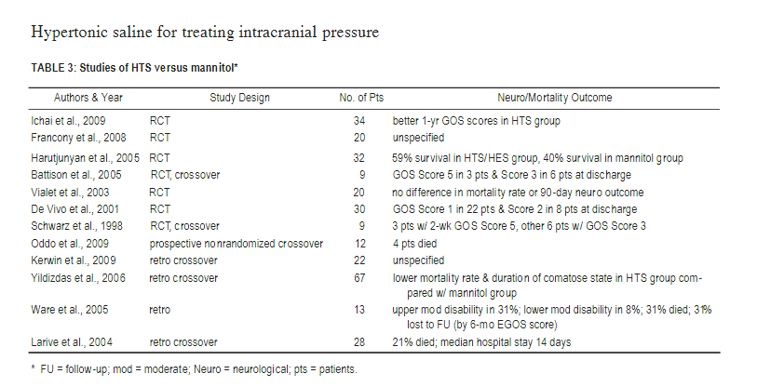
1. GREATER AND MORE SUSTAINED ICP REDUCTION
Mortazavi et al., 2012
Study​ Design | ​Literature review with meta-analysis PubMed search of literature regarding HTS use in elevated ICP 12 articles comparing HTS to mannitol
Findings (n=12) | Greater reduction in ICP in 6 trials | 9 out 12 articles HTS superior to mannitol (5 class I) | Longer duration of ICP reduction found in 2 articles

Slide 23
2. HTS HAS BEEN USED EFFECTIVELY TO REDUCE ELEVATED ICP REFRACTORY TO MANNITOL
Eskandari et al., 2013
Study​ Design | ​Prospective cohort study Adult TBI patients with sustained ICP > 30 mm Hg for more than 30 minutes Standard-of-care medical and/or surgical therapy received Intervention: 15-minute boluses of 40 mL 14.6% HTS Repeated every hour over the course of 12 hours if ICP remained elevated (>20 mmHg)
Findings (n=11, 56 boluses) | Mean ICP reduction: 30% (p<0.05) 5 minutes after bolus: decrease of 40 ± 12 mm Hg at baseline to 33 ± 10 mm Hg (p < 0.05) 10 minutes after bolus: decrease of 28 ± 9 mm Hg (p < 0.05) Average length of ICP < 30 mmHg: 12 hours (41% reduction, p<0.05) Mean CPP: Increase 22% from baseline at 15 minutes (p<0.05) Increase 32% from baseline at 30 minutes (p<0.05)
Eskandari, 2013

Slide 24
3. HTS HAS REDUCED RATES OF TREATMENT FAILURE Compared to Mannitol
Han et al., 2022
Study​ Design | ​Meta-analysis search up to July 2021 OR and MD with 95% CIs to assess the effect of HTS compared to mannitol for TBI
Findings (n=17 studies with 1392 participants) | Hypertonic saline had: Significantly lower treatment failure (OR, 0.38; 95% CI, 0.15-0.98, p = 0.04, I2 = 50%) Lower intracranial pressure 30–60 mins after infusion termination (MD, −1.12; 95% CI, −2.11 to −0.12, p = 0.03, I2 = 85%) Higher cerebral perfusion pressure 30–60 mins after infusion termination (MD, 5.25; 95% CI, 3.59–6.91, p < 0.001, I2 = 94%)
Han, 2022

Slide 25
4. HTS Associated with Lower Cost Compared to Mannitol
One cost analysis showed:
$14.02/100 g of 20% mannitol IV solution
$0.30/30 ml 3% saline solution
Treatment for 1 day of therapy for 70 kg patient
Mannitol: 0.25-0.5 g/kg every 2 to 6 hours
Maximum cost:
$29.44 (210 g, 0.25 g/kg)
$58.88 (420 g, 0.5 g/kg)
3% HTS: 1.0-4.0 mL/kg
3% HTS Maximum Cost: $0.30 for initial bolus dose (30 mL)
$3.60 for 12 bolus doses
Llorente et al., 2015; Essentia Health WAC
Notes:
Chad – bags 3% HTS versus vials of mannitol

Slide 26
Mannitol is not inferior to hts
For the treatment of elevated icp after tbi

Slide 27
Mannitol is not inferior to hts in the treatment of elevated icp after TBI
Some studies show no difference in reduction of Icp
Potential difference in icp reduction may not be clinically relevant
There is not data to show a difference in mortality or long-term outcomes
mannitol is more readily available than hts

Slide 28
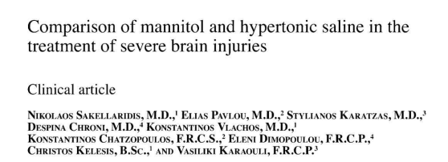
1. no difference in ICP Reduction
Sakellaridis et al., 2011
Study | Cross-over 20% mannitol (2 mL/kg) infusion vs. 15% NaCl (0.42 mL/kg) bolus Primary outcome: reduction in ICP
Findings (n=29) | Mean decrease in ICP
 | Mannitol | HTS | P value
 | 7.96 mmHg | 8.43 mmHg | 0.586
 | Mean duration of effect
 | Mannitol | HTS | P value
 | 3 h 33 min | 4 h 17 min | 0.40
Notes:
-29 patients were treated with alternating treatment protocols
-Equal osmotic burden
-Mannitol infused over 20 minutes, Saline bolus

Slide 29
1. no difference IN ICP Reduction
Cottenceau et al., 2011
Study | RCT 20% mannitol (4 mL/kg) vs 7.5% NaCl (2 mL/kg) Primary outcomes reduction in ICP
Findings (n=47) |  | Mannitol | HTS | P value
 | ICP Prior to infusion | 16.3 + 9.3 | 17.9 + 9.9 | Not significant
 | ICP 30 min after infusion | 10.5 + 6.8 | 12.2 + 6.1 | Not significant
 | ICP 120 min after infusion | 13.6 + 7.5 | 13.9 + 7.8 | Not significant
Notes:
-Equal osmolarity
-Patients randomized to receive either mannitol 4 mL/kg or 7.5% hts 2 mL/kg when ICP >15 mm Hg
-Recorded ICP prior to infusion and at 30 minutes and 2 hours after infusion. A larger reduction occurred after in the mannitol group, but was not statistically significant. By 2 hours, the reduction in ICP had equalized.

Slide 30
1. no difference in ICP reduction
 | Francony et al., 2008
Study | Parallel RCT 20% mannitol (single 231 mL dose) vs 7.45% HTS (single 100 mL dose) Primary outcomes: Reduction in ICP | Parallel RCT 20% mannitol (single 231 mL dose) vs 7.45% HTS (single 100 mL dose)
Findings (n=20) *17 of 20 had TBI |  | Mannitol | HTS
 | ICP reduction 30 min after infusion | 41% + 23% | 37% + 18%
 | 60 min | 45% + 19% | 35% + 14%
 | 90 min | 35% + 12% | 31% + 15%
 | 120 min | 32% + 12% | 23% + 10%
Notes:
- Patients with elevated ICP randomized to receive either
-equal osmolar doses
-Authors measured ICP at 30, 60, 90 and 120 minutes after the infusion and reported it as % difference
-Difference in % ICP reduction was higher in the mannitol group but not statistically significant due to overlapping confidence intervals

Slide 31
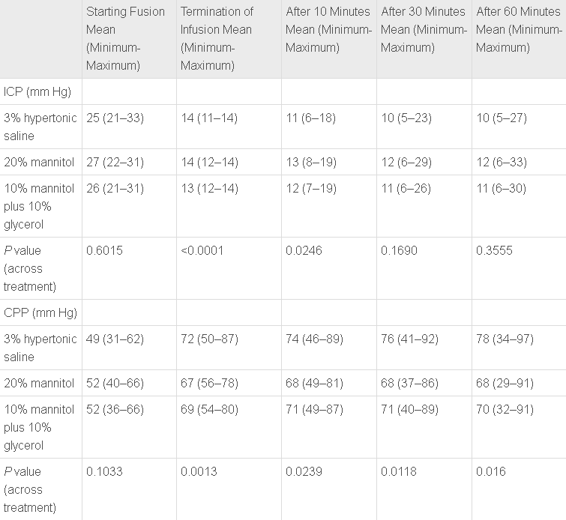
2. Potential difference IS NOT clinically relevant
Findings (n=120)
Patil and Gupta, 2019
Study | RCT Equal osmolar doses of 3% NaCl vs 20% mannitol vs 10% mannitol + 10% glycerol on the reduction of ICP in patients with TBI Outcomes: ICP reduction and CPP increase
General TBI treatment goals:
Maintain ICP <22 mmHg
Maintain CPP between 60-70 mmHg
ICP in health individuals: 7-15 mmHg
CPP in health individuals: 60-80 mmHg
Notes:
CCP >70 in TBI associated with respiratory complications such as ARDS and poor outcomes
https://pubmed.ncbi.nlm.nih.gov/10616075/
file://ctxfs/tshome$/erin5210.MEDCAMPUS/Windows/Downloads/Guidelines_for_the_Management_of_Severe_Traumatic.3.pdf
https://www.sciencedirect.com/topics/medicine-and-dentistry/cerebral-perfusion-pressure
Icp https://jnnp.bmj.com/content/75/6/813
Ccp statpearls
-120 randomized to three groups: mannitol, hts, or mannitol + glycerol

Slide 32
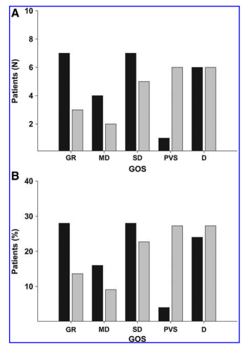
3. No difference in mortality or long-term outcomes
Cottenceau et al., 2011
Study | RCT 20% mannitol (4 mL/kg) vs 7.5% NaCl 2 (mL/kg) Primary outcome: GOS at 6 months
Findings (n=47) | No difference in GOS score at 6 months
Black: mannitol
Gray: HTS
Glasgow Outcome Scale:
5) GR: good recovery
4) MD: moderate disability
3) SD: severe disability
2) PVS: persistent vegetative state
1) D: Death
Notes:
Mentioned this study earlier
-Equal osmolarity
-Patients randomized to receive either mannitol 4 mL/kg or 7.5% hts 2 mL/kg when ICP >15 mm Hg
Followed patients for 6 mo to assess their GOS

Slide 33
3. No difference in mortality or long-term outcomes
Mangat et al., 2015
Study | Retrospective case-control HTS vs mannitol (patient specific dosing) Primary outcome: reduction cumulative and daily ICP
Findings (n=50; n=72) | 1:1 matching
 | 2-week mortality=n (%) | Mannitol | HTS | P value
 |  | 2(8) | 1(4) | 0.56
 | 1:2 matching
 | 2-week mortality=n (%) | Mannitol | HTS | P value
 |  | 4(8.3) | 1(4.2) | 0.53
Notes:
-Patients who received individualized doses of hts or mannitol 1:1, and then again 1 hts to 2: mannitol for sensitivity analysis
Primary outcome was reduction in cumulative and daily ICP, which the study found hts to be more effective
However secondary outcome was morality at 2 weeks, which was not different between the two groups

Slide 34
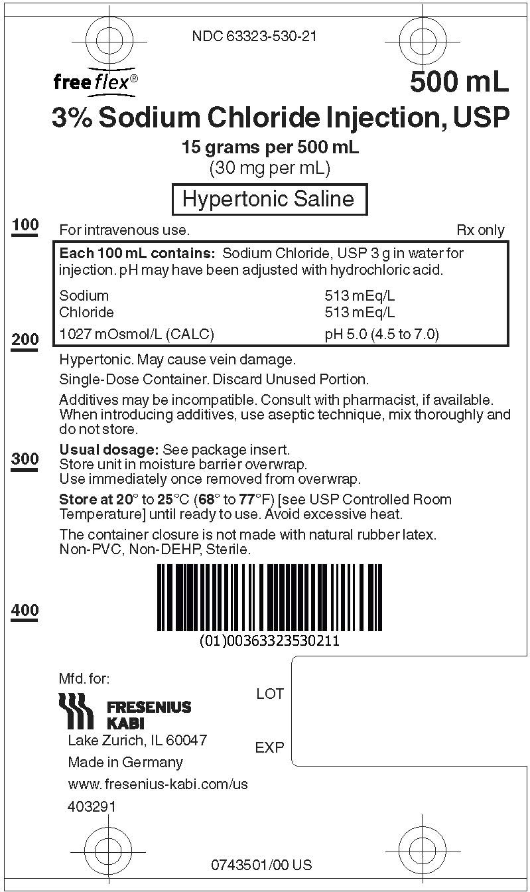
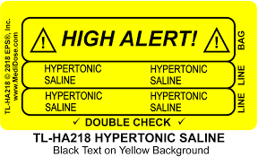
4. Mannitol is more readily available than hts
Elevated ICP is medical emergency and requires immediate action
HTS only available premixed in 3%
Due to significant safety concerns, storing HTS on patient units is controversial and not allowed in many institutions
Delay in administration
Many of the studies used higher concentrations of saline
Requires compounding
Risk of error
Delay in administration

Slide 35
rebuttals

Slide 36
Rebuttal #1: Affirmative

Slide 37
Rebuttal #1: affirmative
1. Some studies show no differences in reduction of ICP
Sakellaridis et al., 2011:
Small sample size (n=29)
Crossover, single site – lacks external validation
Compared 20% mannitol to 15% HTS
15% not commercially available – relevance to current practice?
Cottenceau et al.
Magnitude of ICP decrease and CPP increase appeared to be more pronounced following HTS
Especially with diffuse brain injury

Slide 38
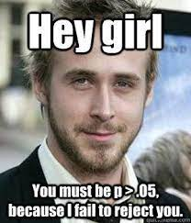
Rebuttal #1: affirmative
1. Some studies show no differences in reduction of ICP
Francony et al.
Grouped patients with TBI, stroke, and intracerebral hemorrhage together

Slide 39
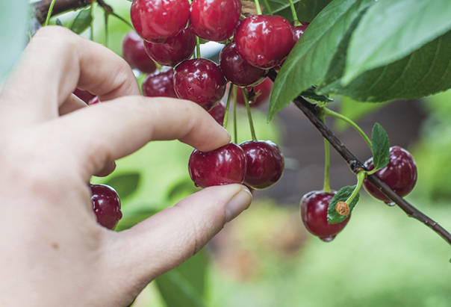
Rebuttal #1: affirmative
1. Some studies show no differences in reduction of ICP
The bigger picture:
Meta-analyses have shown differences in ICP reduction between mannitol and HTS among several trials (Mortazavi et al., 2012, Han et al., 2022)
The Mortazavi et al. meta-analysis included the Francony et al. study
The Han et al. meta-analysis included Francony et al., Cottenceau et al., and Sakellaridis et al. studies

Slide 40
Rebuttal #1: affirmative
2. Potential difference may not be clinically relevant
Patil and Gupta, 2019
One clinically significant difference detected:
Time to reduce ICP below 15 mmHg
"Time is tissue"
Elevated ICP is a medical emergency and every minute above >20 mmHg can lead to further damage

Slide 41
Rebuttal #1: affirmative
3. No differences in mortality or long-term outcomes
Mannitol was not shown to reduce Glasgow Outcome Scales either
Hypothetical benefits may help substantiate greater HTS use
More sustained decrease in ICP
Increased CPP
Ability to treat refractory elevated ICP when mannitol has been used
Glasgow Outcome Scale:
5) GR: good recovery
4) MD: moderate disability
3) SD: severe disability
2) PVS: persistent vegetative state
1) D: Death
Han et al., 2022; Mangat et al., 2020; Martazavi et al., 2012

Slide 42
Rebuttal #1: affirmative
4. Mannitol is more readily available than HTS
No drug is exempt from shortages that may delay care (especially old, generic medications such as mannitol)
Mannitol has been in and out of shortage for many years
Mannitol also has safety concerns with storage and administration
Mannitol crystalizes at ambient room temperatures
Weight-based dosing leaves room for medication error (which dosing to use?)

Slide 43
Rebuttal #2: Negative

Slide 44
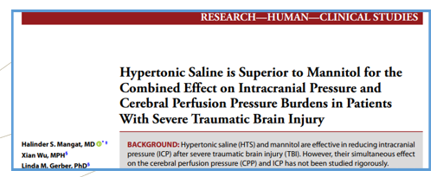
Rebuttal #2: Negative
1. HTS has a greater and more sustained ICP reduction than mannitol
Mangat 2020
Prospective case-control (n=25;48), studied effects of HTS vs mannitol on ICP and CPP
Patients in the mannitol group had higher cumulative duration of MAP <80 mm Hg (28 hours vs 32 hours)
Difference did not reach statistical significance but may have skewed CPP measurements in favor of saline
Mannitol doses reported as a range of grams/day (0-50, 51-100, 101-200, 201-600 g/d)
Mannitol dose is weight-based; unable to assess dosing appropriate

Slide 45
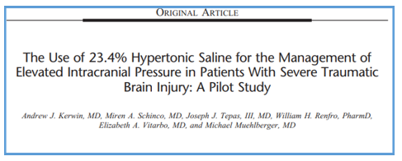
Rebuttal #2: Negative
1. HTS has a greater and more sustained ICP reduction than mannitol
Kerwin 2009
Retrospective case-control (n=22), studied 23.4% HTS vs mannitol
Authors reported “no patient received only mannitol or only HTS”
Maintained separate mannitol and HTS groups without elaborating further
Cannot rule-out residual effects of previous agent
Mannitol 15 g – 75 g bolus vs. 23.4% saline bolus
Did not elaborate further on mannitol dosing
Mannitol dose is weight-based; unable to assess dosing appropriate
Pentobarbital-induced coma in 10 patients
Did not report which patients
Did not address other measures such as CSF draining or decompressive craniectomy
Small sample size (n=22); not powered to detect a true difference
Notes:
This trial only had 22 patients, which if you remember from a few minutes ago, is a very big deal to my opposition , so I’m surprised she included it

Slide 46
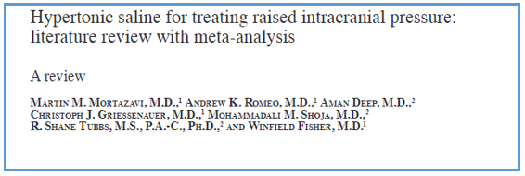
Rebuttal #2: Negative
1. HTS has a greater and more sustained ICP reduction than mannitol
Mortazavi 2012
Literature and meta-analysis comparing HTS and mannitol on ICP
Includes 2009 study by Kerwin et al.
Was already addressed separately by the affirmative (double-counted data)
Lit review separated into categories: 1) Studies of HTS vs mannitol, 2) Studies of continuous infusion, 3) Studies of bolus therapy, 4) Studies of TBI, 5) Studies of nontraumatic injury, 6) Studies of mixed traumatic and nontraumatic neurological injury, 7) Studies of pediatrics
Only 16 of the 36 studies included were on patients with TBI
Outcomes cited by the affirmative were regarding the HTS vs mannitol category, and may not have included patients with TBI

Slide 47
Rebuttal #2: Negative
2. HTS reduces elevated ICP refractory to mannitol
Eskandari 2013
Prospective cohort study (n=11), studied effect of repeated boluses of high-concentration HTS on severely refractory ICP elevation
11 patients with sustained ICP > 30 mm Hg for > 30 minutes after medical and/or surgical therapy received repeated 15-minute boluses of 14.6% HTS over 12 hours
Can safely assume “medical therapy” likely refers to mannitol or normal dose HTS
Patients received massive doses of osmolar therapy from HTS, after receiving likely normal doses of mannitol
Study does not compare HTS to mannitol.
Study is trying to demonstrate that very high doses of HTS can be effective in reducing refractory ICP in a “last-ditch” effort

Slide 48
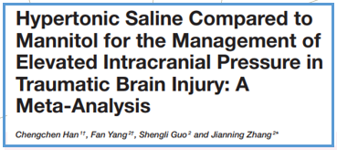
Rebuttal #2: Negative
3. HTS has reduced rates of treatment failure compared to mannitol
Han 2022
Meta-analysis (n=17), studied HTS vs mannitol for ICP reduction after TBI
Included Kerwin et al. and Mangat et al.
Mangat el al. results reported once previously, Kerwin et al. results reported twice previously by the affirmative (double-counted data)
Reported lower rates of treatment failure with HTS, but “treatment failure” is not defined
Possibly failure to reach ICP < 22 mm Hg after one dose of HTS or mannitol?
Cannot assess outcome because outcome is not defined

Slide 49
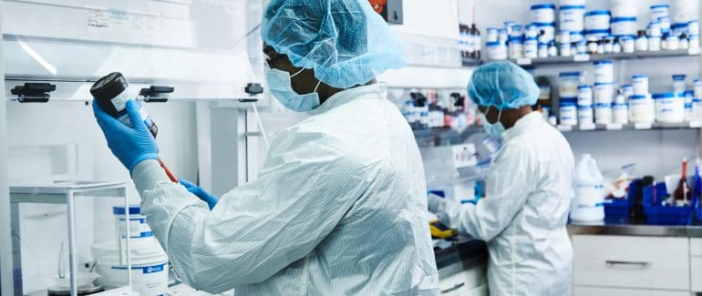
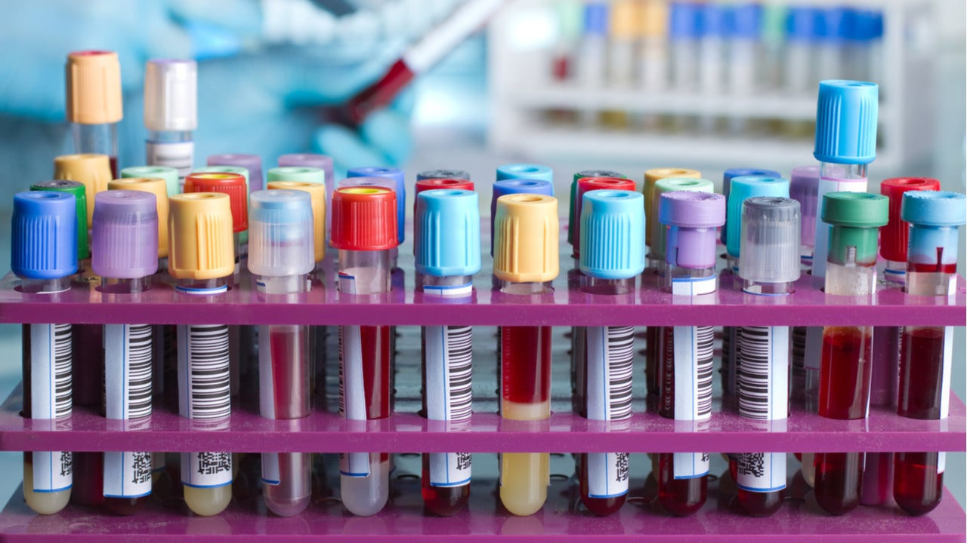
Rebuttal #2: Negative
4. HTS is estimated to cost less than mannitol
Unmeasured, unreported costs of HTS:
Cost of compounding
Usually requires ISO 5 environment, trained pharmacy technician, sterile garb, multiple sterile products, pharmacist final check
Manual medication delivery
Frequent (every 4-6 hour) electrolyte checks
Phlebotomy blood draw, laboratory testing, professional interpretation of result

Slide 50
conclusion

Slide 51
conclusion
HTS should be used first line in most patients
HTS is as good as, if not better, than mannitol
Literature tends to favor HTS of mannitol for reduction of ICP
Improved ICP reduction → Improved long term outcomes?
Mannitol might be considered for certain patients:
Acidotic or hypernatremic at baseline
Fluid overloaded
Unable to access HTS (e.g. rural institution)

Slide 52
THANK YOU
Erin Beauclair and Elli Emmerson
Erin.beauclair@essentiahealth.org
Elizabeth.emmerson@essentiahealth.org

Slide 53
References
“TBI Data | Concussion | Traumatic Brain Injury | CDC Injury Center,” March 21, 2022. https://www.cdc.gov/traumaticbraininjury/data/index.html.
“Moderate and Severe TBI | Concussion | Traumatic Brain Injury | CDC Injury Center,” May 12, 2021. https://www.cdc.gov/traumaticbraininjury/moderate-severe/index.html.
Pinto, Venessa L., Prasanna Tadi, and Adebayo Adeyinka. “Increased Intracranial Pressure.” In StatPearls. Treasure Island (FL): StatPearls Publishing, 2022. http://www.ncbi.nlm.nih.gov/books/NBK482119/.
Mokri B. The Monro-Kellie hypothesis: applications in CSF volume depletion. Neurology. 2001;56(12):1746-1748. doi:10.1212/wnl.56.12.1746
Sharma S, Hashmi MF, Kumar A. Intracranial Hypertension. [Updated 2022 Aug 18]. In: StatPearls [Internet]. Treasure Island (FL): StatPearls Publishing; 2022 Jan-. Available from: https://www.ncbi.nlm.nih.gov/books/NBK507811/
Freeman, N and Welbourne, J. Osmotherapy: science and evidence-based practice. BJA Educ. 2018 Sep;18(9):284-290.
Cook, A, et al. Guidelines for the acute treatment of cerebral edema in neurocritical care patients. Neurocrit Care. 2020 May;32(3):647-666.
Biological membranes. The science hive. Biological Membranes (A-Level) — the science hive. Accessed 10/26/22
Rajajee, V, et al. Management of acute moderate and severe traumatic brain injury. UpToDate. Management of acute moderate and severe traumatic brain injury – UpToDate. Last updated 8/9/22.
American College of Clinical Pharmacy. (2022). CCSAP pharmacotherapy self-assessment program: module. Kansas City, MO: ACCP.
Carney, N, et al. Guidelines for the management of severe traumatic brain injury. Brain trauma foundation. 4th edition. Sep 2016.

Slide 54
References
Mangat HS, Wu X, Gerber LM, et al. Hypertonic Saline is Superior to Mannitol for the Combined Effect on Intracranial Pressure and Cerebral Perfusion Pressure Burdens in Patients With Severe Traumatic Brain Injury. Neurosurgery. 2020;86(2):221-230. doi:10.1093/neuros/nyz046
Kerwin AJ, Schinco MA, Tepas JJ 3rd, Renfro WH, Vitarbo EA, Muehlberger M. The use of 23.4% hypertonic saline for the management of elevated intracranial pressure in patients with severe traumatic brain injury: a pilot study. J Trauma. 2009;67(2):277-282. doi:10.1097/TA.0b013e3181acc726
Mortazavi MM, Romeo AK, Deep A, Griessenauer CJ, Shoja MM, Tubbs RS, Fisher W: Hypertonic saline for treating raised intracranial pressure: literature review with meta-analysis. J Neurosurg 2012, 116: 210-221. 10.3171/2011.7.JNS102142
Eskandari R, Filtz MR, Davis GE, Hoesch RE. Effective treatment of refractory intracranial hypertension after traumatic brain injury with repeated boluses of 14.6% hypertonic saline. J Neurosurg. 2013;119(2):338-346. doi:10.3171/2013.4.JNS121541
Jagannatha AT, Sriganesh K, Devi BI, Rao GS. An equiosmolar study on early intracranial physiology and long term outcome in severe traumatic brain injury comparing mannitol and hypertonic saline. J Clin Neurosci. 2016;27:68-73. doi:10.1016/j.jocn.2015.08.035
Han C, Yang F, Guo S, Zhang J. Hypertonic Saline Compared to Mannitol for the Management of Elevated Intracranial Pressure in Traumatic Brain Injury: A Meta-Analysis. Front Surg. 2022;8:765784. Published 2022 Jan 7. doi:10.3389/fsurg.2021.765784
Llorente, Gisela, and Maria Claudia Niño de Mejia. “Mannitol versus Hypertonic Saline Solution in Neuroanaesthesia.” Colombian Journal of Anesthesiology 43 (January 1, 2015): 29–39. https://doi.org/10.1016/j.rcae.2014.07.010.
Sakellaridis, N, et al. Comparison of mannitol and hypertonic saline in the treatment of severe brain injuries. J Neurosurg. 2011 Feb;114(2)545-8.
Cottenceau, V., et al. Comparison of effects of equiosmolar doses of mannitol and hypertonic saline on cerebral blood flow and metabolism in traumatic brain injury. J Neurotrauma. 2011 Oct;28(10):2003-12.
Francony, G., et al. Equimolar doses of mannitol and hypertonic saline in the treatment of increased intracranial pressure. Crit Care Med. 2008 Mar;36(3):795-800.
Patil, H and Gupta, R. A comparative study of bolus dose of hypertonic saline, mannitol, and mannitol plus glycerol combination in patients with severe traumatic brain injury. World Neurosurg. 2019 May;125:e221-e228.
Mangat, H., et al. Hypertonic saline reduces cumulative and daily intracranial pressure burdens after severe traumatic brain injury. J Neurosurg. 2015 Jan;122(1):202-10.

Slide 55
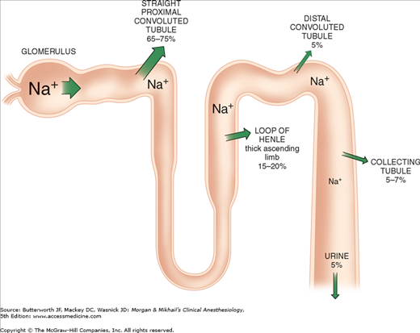
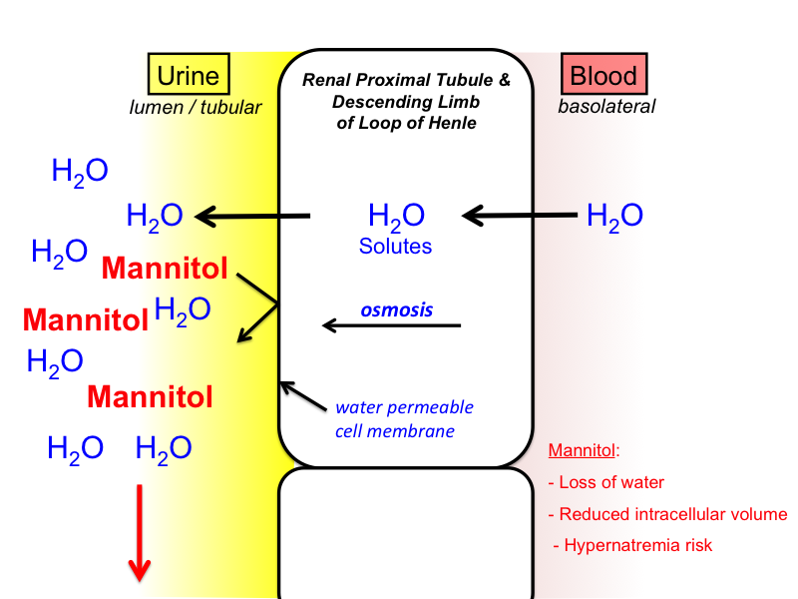
Why is HTS not also an osmotic diuretic?
Notes:
Mannitol is not reabsorbed from the renal tubule

Slide 56
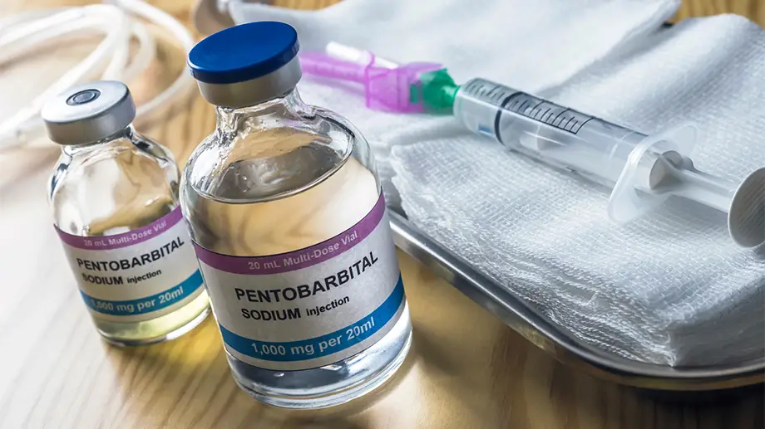
Pentobarbital-incuded coma
Reduction in tissue oxygen consumption
Reduction in metabolic rate
Reduction in cerebral blood flow
Decrease neuro-excitotoxicity (via reduction of glutamate and aspartate)
Blood vessels narrow
Brain volume shrinks
Reduced intracranial pressure

Slide 57
Respiratory complications in cpp >70 mmhg
2016 TBI guideline: "Avoid aggressive attempts to maintain CPP>70 mmHg due to risk of ARDS"
Compared goals of CPP >50 mmHg and >70 mmHg
Found patients in the higher CPP group experienced statistically significant for ARDS than patients in the lower CPP group

Slide 58
CPE Instructions for: NDSHP Drug Therapy Series 12/13/22 Hypertonic Saline Versus Mannitol For Treatment of Elevated Intracranial Pressure in Traumatic Brain Injury
1
2
2
3
Redeem your credit online at
CEimpact.com
*If this is the first time you have utilized the CEimpact Learning Management System (LMS) you will need to create an account.
From the CEimpact.com Homepage – enter the code provided in the ‘Enter Code’ box and click SUBMIT.
Complete the Exam & Evaluation as prompted; click SUBMIT to send your information to CPE Monitor. Follow instructions to access your CPE Statement of Credit on CPE Monitor or access your Certificate of Completion in MyCourses.
Pharmacist Code: LewJ22
The deadline for obtaining your CPE Credit is 30 days from today. The deadline is non-negotiable due to CPE Monitor reporting policies. For CME, access your certificate of completion in My Courses for this course.

