Slide 1
Acute Care Networking Meeting
NDSHP – Tuesday, July 25th, 2023
Laura John, PharmD, BCPS
Laura.john@essentiahealth.org

Slide 2
Residency Preceptor Pearls Discussion

Slide 3
New Preceptor Orientation
Does your site have dedicated time set aside to orient your new preceptors?
If so – what does your orientation look like
If not – what do you do to adequately prepare your preceptors?
Overview of PGY1 and/or PGY2 residency
Goals, structure, policies, resident responsibilities, preceptor responsibilities

Slide 4
Preceptor Development
What is your site doing to promote preceptor development?
Informal or formal presentations?
Attending local, state, or national conferences?
Do you have requirements your preceptors must maintain?

Slide 5
Preceptor Feedback
Addressing any deficiencies in preceptor performance and ensuring appropriate training is received to correct deficiencies
Does your site do this?
Who is responsible for ensuring preceptor performance is appropriate?
How do you ensure appropriate training is received?

Slide 6
Preceptor Feedback
Ongoing self-evaluation of their own preceptor skills by listening to the feedback they receive from the residents, other preceptors and the RPD
How do preceptors receive feedback?
Other ways your site uses besides PharmAcademic?

Slide 7
ASHP Pharmacy Forecast 2023

Slide 8
Addressing Health Disparities in Health Systems: From Awareness to Action

Slide 9
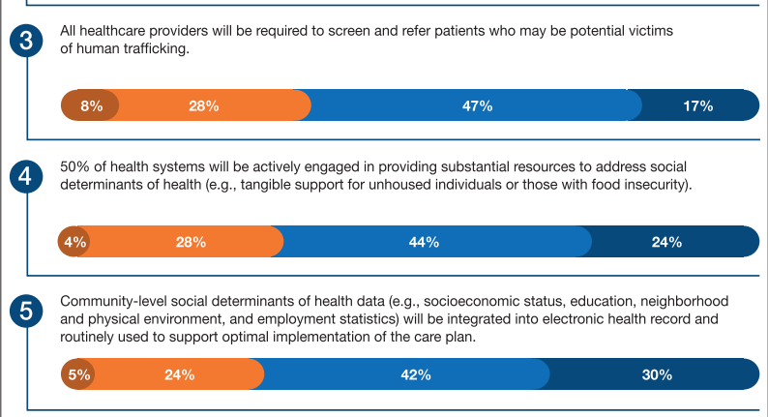
Social Determinants of Health

Slide 10
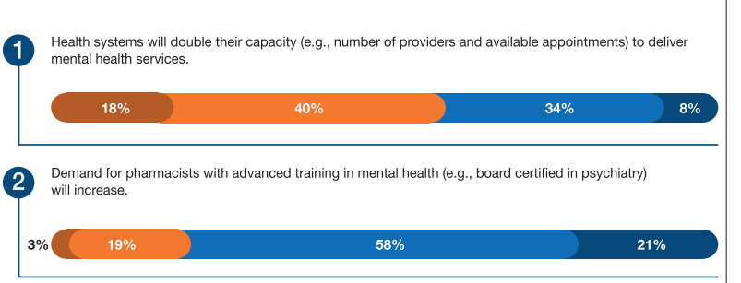
Mental Health

Slide 11
Workforce Diversity

Slide 12
Acute Care Networking Meeting
NDSHP – Tuesday, July 25th, 2023
Laura John, PharmD, BCPS
Laura.john@essentiahealth.org

