Slide 1
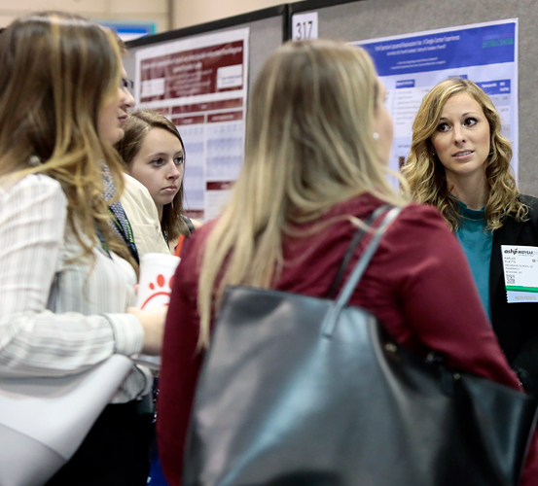
GETTING INVOLVED
ASHP Engagement Opportunities
North Dakota State University
Kelsey Ihry

Slide 2
Agenda
About
ASHP
ASHP
Resources
Engagement
Opportunities
Leadership
Opportunities

Slide 3
My Involvement
Notes:
Use this slide to insert information about your school-level Clinical Skills Competition. To achieve ASHP-SSHP recognition, student societies are required to hold one school-level Clinical Skills Competition and send one team of two students to the CSC at the Midyear Clinical Meeting. If your society is not yet recognized by ASHP and you have a Clinical Skills Competition, use this slide to put in specific details about the event.

Slide 4
About ASHP

Slide 5
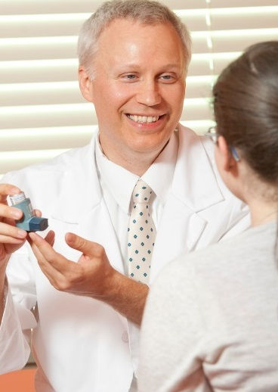
About ASHP
Collective voice for members on issues related to medication use and public health
For 75 years, ASHP remains at the forefront to improve medication use and enhance patient safety

Slide 6
About ASHP
Founded in 1942
Headquarters in Bethesda, MD
200+ staff
Elected Board of Directors and Officers

Slide 7
About ASHP
Mission
To help people achieve optimal health outcomes.
Vision
Medication use will be optimal, safe, and effective for all people all of the time.

Slide 8
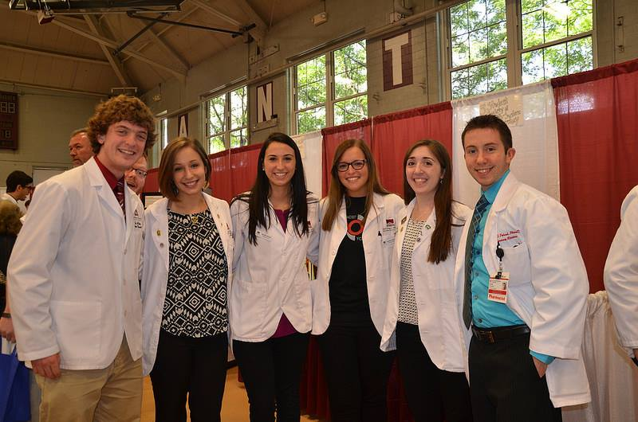
ASHP Membership
Pharmacists
nearly
50,000
Student Pharmacists
Pharmacy Technicians

Slide 9
ASHP Core Strengths
Pharmacists Advancing Healthcare

Slide 10
Role of ASHP
Serve as a community of professionals with similar interests
Express and exercise the collective will of members
Build consensus on practice issues
Build public understanding and support for the profession
Improve and advance practice

Slide 11
ASHP Resources

Slide 12
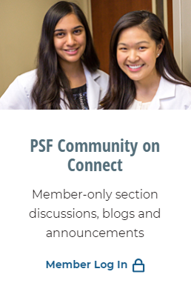
ASHP Connect Community
Network
Share your thoughts and engage with other students
Easy-to-use online interface
Free to ASHP members

Slide 13
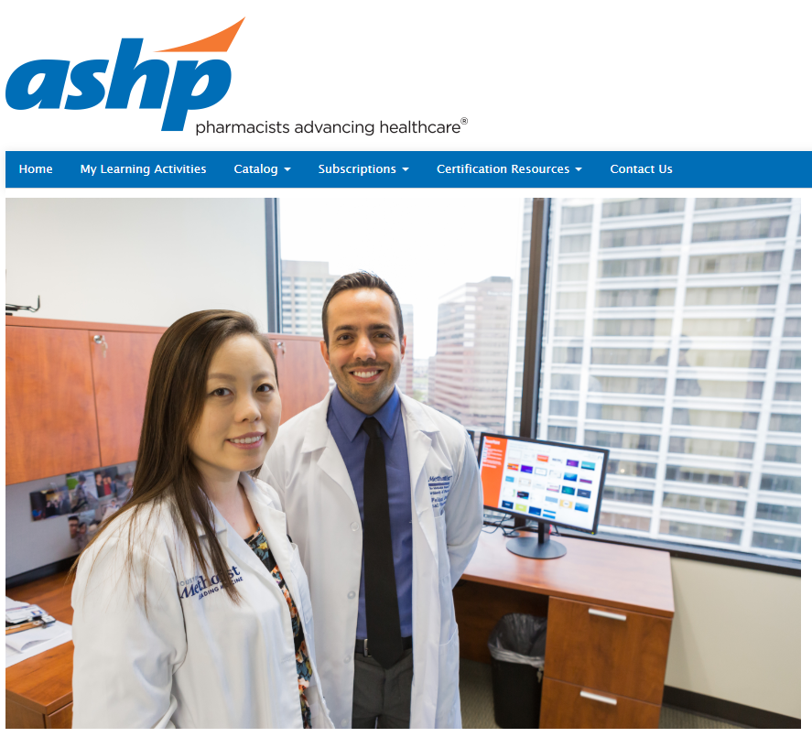
ASHP Webinars
Free, member-only
http://elearning.ashp.org/
Recorded webinars
Learn about valuable and relevant health-system pharmacy topics
Career and professional development
Leadership and management
Mentoring

Slide 14
Other Resources
Student Residency Guide
Application process
Transitioning to a new practitioner
Career Development
Interviewing tips
Career planning
Advocacy
Tips and tools for student pharmacists
Updates on key Issues

Slide 15
Programmatic Opportunities
Mentor Match
Online, user-driven tool
Searchable database
Registered Mentees/Mentors can search using specified criteria
Search by experience and expertise
Mentor Match is a free benefit of membership and is available only to members

Slide 16
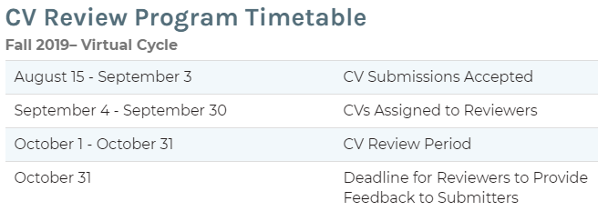
Programmatic Opportunities
Curriculum Vitae (CV) Review Program
Submitted CVs assigned to volunteer reviewers
Experienced ASHP members
Provide quality feedback

Slide 17
Student Programming at ASHP Meetings
Summer Meeting
Meet and Greet with Pharmacy Leaders
Strategies for Personal and Professional Success Workshop
Teamwork: A Key to Effective Leadership
Exhibit Hall
Student Advocacy Workshop

Slide 18
Student Programming at ASHP Meetings
Midyear Clinical Meeting
SSHP Leaders Workshop
Student Advocacy Workshop
Pharmacy Student Forum Opening Session
Mysteries of the Match
Clinical Skills Competition Presentations
Strategies for Personal and Professional Success
Effective CV and Self Marketing
Student Society Showcase
Student Poster Session

Slide 19
Engagement Opportunities

Slide 20
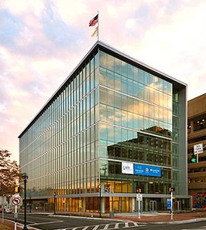
Summer Internship
10-week training program
Based at ASHP Headquarters
Intern attends ASHP Summer Meeting
P1-P3 students are eligible
Deadline: end of January each year
ASHP Headquarters
Bethesda, MD

Slide 21
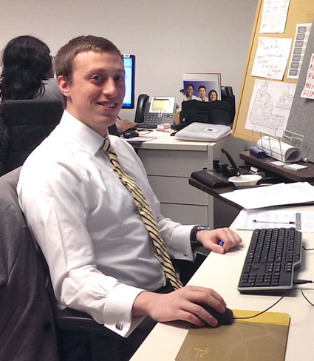
Experiential Education Rotation
Elective-national association management
ASHP Headquarters
4-6 weeks
4th Professional Year students (APPE)
Rolling admission
https://www.ashp.org/Pharmacy-Student/Programs-and-Awards/ASHP-Experiential-Education-Program

Slide 22
Leadership Opportunities

Slide 23
Pharmacy Student Forum (PSF)
Mission
“…to represent student pharmacists, to provide professional development resources, and develop an engaged community that will lead and advocate for the pharmacy profession.”

Slide 24
Pharmacy Student Forum (PSF)
PSF Executive Committee
Advisory Groups
Student Societies of Health-System Pharmacists (SSHP)
Student Members

Slide 25
PSF Executive Committee
5 Student appointees (Chair, Vice-Chair, 3 members)
Represent the voice of the PSF
Commitment
Term of service: June-May
Attend MCM and Summer Meeting
Frequent conference calls, emails
Advisory Group Liaison
Provide strategic guidance to ASHP staff
Encourage member participation
Applications due Mid-November each year

Slide 26
PSF Advisory Groups
Advancement of Pharmacy Practice
Career and Leadership Development
Community and eCommunications
Policy and Legislative Advocacy
Student Society Development

Slide 27
PSF Advisory Groups (cont.)
Serve as advisors to ASHP on relevant issues
Each AG has 1 Chair and 18 members
Appointed by Chair of Executive Committee
Network with other students from across the nation
Commitment
Frequent e-mail communications, conference calls, in-person meeting at Midyear Clinical Meeting
Application deadline: May 1

Slide 28
ASHP Councils
Education and Workforce Development
Pharmacy Management
Pharmacy Practice
Public Policy
Therapeutics
Notes:
-policy recommending bodies
-each council has 1 appointed student member
-Policy Week occurs each September where the members of the councils get together to review policies and recommend changes and/or new policies for the HOD to review.

Slide 29
Key Takeaways

Slide 30
Why Get Involved?
Resources
Residency bound
Leadership, communication, time-management skills
Advancing our profession
NETWORKING!

Slide 31
Getting Started
Local
Become a leader in your SSHP
State
Join and participate in your state affiliate
National
Apply to be on an Advisory Group, Executive Committee, Council, etc.
Volunteer at meetings
Organize outreach projects
Help new alumni
Post on ASHP Connect and network with other students from across the nation

Slide 32
Notable Deadlines
ASHP Summer Internship
(End of January every year)
Council and Executive Committee
(Mid-November
every year)
APPE
(Rolling admission)
Advisory Groups
(May 1st)

Slide 33
QUESTIONS
Kelsey Ihry

