Slide 1
Hypertension and Hyperlipidemia;
Using Guidelines and Health Coaching to Optimize Patient Outcomes
CDR Christel Svingen, PharmD, BCPS, NCPS

Slide 2
Objectives
Incorporate current guidelines for hypertension and hyperlipidemia to maximize patient care.
Apply key concepts of health coaching to optimize patient outcomes by eliciting change response.
Notes:
My goal is not to bore you today with a regurgitation of hypertension and hyperlipidemia guidelines. My plan is to present an overview of the guidelines, discuss key differences in previous guidelines, and most importantly, how to apply the guidelines to specific patient situations. And then also sprinkling in some health coaching.

Slide 3
Disclosures
I have no disclosures.

Slide 4
Health Coaching
What is health coaching?
  “A process that facilitates healthy, sustainable behavior change by challenging a patient to listen to their inner wisdom, identify their values, and transform their goals into action.” ²¹
  Getting the patient to do what you want them to do without telling them what to do. ¹⁹
Notes:
OK…great. What does that mean?

Slide 5
Health Coaching
What is the difference between traditional counseling and health coaching?
  Traditional counseling:
    Telling the patient what they need to do, how they need to do it, and what their goals should be
  Health coaching:
    Establish a relationship - Building trust through engagement
    Motivational interviewing -
      The patient’s knowledge, strengths, values, and desires are recognized
      Ambivalence to change is addressed
      Engage intrinsic motivation in order to change behavior
    Goal setting - Specific goals are set collaboratively so the patient is able to move in the direction of his/her newly formed desires. A plan is put in place to track and evaluate progress.
Notes:
Traditional counseling – It is engrained in us throughout our schooling to lecture patients about their medications, disease states, and help fix patients. We’re the experts, right? They’ll listen to us, right? Sure, it may work for some patients, but research shows that knowledge alone does not promote change. When an understanding of motive is added to the knowledge base, then change is likely to occur. Most people know what to do and what’s good for them, it’s just a matter of reminding them what motivates them to make those changes, especially when it comes to chronic illnesses.
You first need to establish a relationship by building their trust. This is very important because in order for this process to work, they need to trust you and feel comfortable discussing their thoughts, ideas, and private lives. If you don’t trust someone, you don’t disclose information to them or are honest with them.
Get to know the patient…what they already know, what they are capable of, and what they want.
3. Then find out what’s holding them back?
4. And then what motivates them to change their behavior?
5. Finally, goals are set collaboratively with the patient and a plan in put in place to evaluate progress.
With traditional counseling, the health care provider does most of the talking; with health coaching, the patient does most of the talking. If you let patients talk, they will talk.

Slide 6
Health Coaching
J.S. is a 37 year old male who presented to his PCP with blurry vision and blood sugar readings of “high” on his glucose meter. He has DMII, hyperlipidemia, hypertension, is obese, and works as an EMT and drives ambulance. His A1c is 11.2 today. He is currently taking metformin, but his PCP prescribed Levemir insulin. He comes to the pharmacy to pick up his diabetes medications and tells the pharmacist that he’s not interested in starting insulin. The pharmacist is at least able to talk him in to taking the medication with him, and then places an DSM consult. I am able to contact him a few days later.
Notes:
At Red Lake, we have an “DSM clinic”, which stands for Disease State Management Clinic. It’s a pharmacist-run clinic that started just over 3 years ago, where clinical pharmacists therapeutically manage patients with diabetes, hypertension, and hyperlipidemia through a collaborative practice agreement. So, all of the patient cases presented today have come for the patients I have seen in our DSM clinic.

Slide 7
Health Coaching
Patient states that:
  He has been injecting his Levemir as taught and as prescribed between 7 and 8 every evening, and taking his metformin.
  He does not check his sugars very often, but when he does, he says that they are in the 500's, but doesn't care or really pay attention to the numbers.
  He does not admit to any hyperglycemic symptoms.
  He is too busy at work, and does not have time for a DSM appt. I would just give him more medications anyway, and he doesn't like when medical people tell him what to do.
How do you respond?
Notes:
Traditional counseling: You need your insulin adjusted, you need to watch what you eat, you need to eat 3 meals a day, you need to check your sugars more…Right? No!
Here’s what I said instead: “I’m worried about you, and I’m here to help you. If you come see me, I won’t tell you what to do. We can discuss your goals and what you think you should do. I understand you don’t have time, but you can stop in at the pharmacy anytime between 8am and 6pm over the next 2 days, if that works for you. If you don’t want to work with me, that’s your choice, but I’m sure you know that your blurry vision will continue as long as your sugars are high, and there is a chance you may end up with sugars so high that you could go in to a diabetic coma and die. But, that’s your choice.”
There was a long silence, and then he said, “OK, I’ll stop by tomorrow.” And I got him!
The patient met with me, we had several phone and face-to-face interactions where goals were made and met. A1c decreased from 11.2 to 5.9, 3&1/2 months later.

Slide 8
Health Coaching
  Establish a relationship
  Motivational interviewing
    Ambivalence to change is addressed
    The patient’s knowledge, strengths, values, and desires are recognized
    Engage intrinsic motivation in order to change behavior
  Goal setting
Notes:
Establish a relationship - I let him know that I am different than other providers. I won’t tell you what to do, I won’t add meds, I won’t tell you what your goals are… I was open to listening to him and what he needed.
Ambivalence to change - He doesn’t have time….didn’t want to deal with it. I told him to come by anytime…no pressure, no judgement.
Desires and motivation for change - He’s an ambulance driver…he wants his vision back.
Goal setting - His goal was to get his sugars back to normal.

Slide 9
Hypertension
  2014 Evidence-Based Guideline for the Management of High Blood Pressure in Adults: Report From the Panel Members Appointed to the Eighth Joint National Committee (JNC 8)

Slide 10






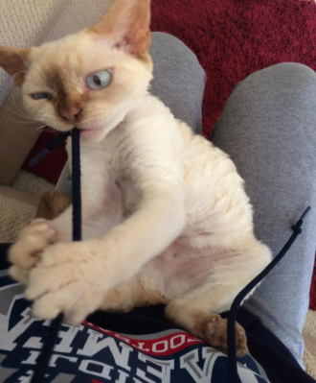

Hypertension
What raises your blood pressure?
Notes:
My husband and I adopted a couple of cats 3 years ago. They’re our babies, but we can’t decide if this one is really smart and naughty at the same time, or just a few bricks short of a full load. Anyway, she sometimes causes problems for us, and THIS is what raises my blood pressure.

Slide 11

Hypertension
Notes:
And this is the well-behaved cat.

Slide 12
Hypertension
Comparison of JNC 7 & JNC 8 ¹
Topic | JNC 7 | JNC 8
Methodology | Nonsystemic literature review included a range of study designs | Critical questions and review criteria defined; restricted to RCT’s
Definitions | Hypertension and prehypertension | Definitions not addressed; thresholds for pharmacologic therapy defined
Treatment goals | Separate treatment goals defined for subsets of patients with comorbid conditions and “uncomplicated” HTN. | Similar treatment goals
Drug Therapy | Recommended 5 classes to be considered as initial therapy with thiazide-type diuretics as initial therapy for most patients. Specified classes of medications for patients with compelling indications (diabetes, CKD, heart failure, MI, stroke, etc.) Comprehensive table of oral antihypertensive medications with names and usual dose ranges. | Recommended selection among 4 specific medication classes (ACEI/ARB, CCB or diuretics) and doses based on RCT evidence. Recommended specific medication classes based on evidence review for certain ethnicities and chronic kidney disease. Table of drugs and doses used in the outcome trials.
Notes:
In order to understand some of the controversy behind JNC8, a review of the differences between JNC7 and JNC8 is necessary.

Slide 13
Hypertension
3 critical questions were identified and addressed to determine thresholds and goals for treating adults with hypertension: ¹
  1. Does initiating antihypertensive pharmacologic therapy at specific
  BP thresholds improve health outcomes?
  2. Does treatment with antihypertensive pharmacologic therapy to a
  specified BP goal lead to improvements in health outcomes?
  3. Do various antihypertensive drugs or drug classes differ in
  comparative benefits and harms on specific health outcomes?
    “Health outcomes” = Mortality (overall, CVD, CKD), myocardial infarction, heart failure, stroke, coronary revascularization, end-stage renal disease¹
Notes:
1. When do you start BP meds? 2. What should the goal BP be? 3. Which BP meds should be used? These questions are all about health outcomes. Do the medications prevent mortality, cerebrovascular disease, cardiovascular disease, and renal disease?

Slide 14
Hypertension
Recommendation 1: ¹
  In patients > 60 years old:
    Goal BP: < 150/90 ; initiate pharmacologic therapy if BP is above goal.
    Side note: If pharmacologic treatment results in a BP less than the goal BP and the patient is not experiencing side effects or a reduced quality of life from pharmacologic therapy, treatment should not be adjusted.
Notes:
Previous JNC7 goals were SBP < 140.

Slide 15
Hypertension
The Controversy!
  Panel members do not unanimously agree with recommendation 1. What’s the big deal?
    National Heart, Lung, and Blood Institute (NHLBI) withdrew from the JNC 8 panel and refused to endorse the guidelines. The American Heart Association (AHA) and American College of Cardiology (ACC) arrangement to endorse the guidelines fell through.
    5 of the original members not only disagreed with the JNC 8 conclusions, but wrote and published “Evidence Supporting a Systolic Blood Pressure Goal of Less Than 150 mm Hg in Patients Aged 60 Years or Older: The Minority View.”
      Raising the target systolic BP in those 60 years or older was based on insufficient and inconsistent data, and may have the unintended effect of reversing decades of declining CVD rates, especially stroke mortality. ¹⁴
Notes:
“After many months of unexpected delays leading up to the report’s release, the NHLBI announced that it would hand off the JNC 8 process to an appropriate medical group. A few weeks later, the institute announced that JNC 8 would be published under the American Heart Association and American College of Cardiology. Then came word that the arrangement had fallen through, leaving what became the former JNC 8 panel to release its data analysis and recommendations without endorsement from a medical association.”
Raising the target systolic BP in those 60 years or older was based on insufficient and inconsistent data, and may have the unintended effect of reversing decades of declining CVD rates, especially stroke mortality. ¹⁴ If you’re interested, the guideline goes into why certain studies included in JNC7 were not included in the methodology for JNC8.

Slide 16
Hypertension
March 10th: S.T. is an 80 year-old Native American woman who has:
RA – MTX (just recently stopped chronic prednisone);
DMII – Levemir 15 units daily, Novolog 2-4 units with meals;
HTN – amlodipine 10mg daily, Lisinopril 20mg daily, carvedilol 12.5mg BID, (intolerance to diuretics);
Hyperlipidemia – gemfibrozil 600mg BID
She is referred to the DSM clinic for diabetes management by her PCP because she has been feeling dizzy on a daily basis, after taking her Novolog with breakfast. This started about 2 months ago. Her A1c 2 weeks ago was 6.3 and has been 6.1-6.4 over the last 2 years. All other labs are WNL. Today, her BP is 105/52, pulse is 52. Her glucose meter was downloaded; most fasting morning blood sugars over the last 3 months are 90-140 with no sugars < 70.
  Previous blood pressures: 188/52 (July), 167/56 (Oct), 178/71 (Nov), 180/73 (Dec), CABG (Dec), 177/52 (Jan), 118/48 (Feb), 102/57 (Feb)

Slide 17
Hypertension
What is the goal BP for this patient, according to JNC 8?
What is causing her dizzy spells?
What medication changes would you make?
Notes:
Quick assessment question:
<150/90 (She is greater than 60 years old)
Her low BP.
Patient is bradycardic, so I decreased the carvedilol from 12.5mg BID to 6.25mg BID. Patient did well.

Slide 18
Hypertension
Recommendations 2 & 3: ¹
  In patients < 60 years old:
    Goal BP: < 140/90; initiate pharmacologic therapy if BP is above goal.
Notes:
DBP < 90: reduces cerebrovascular events, heart failure, and overall mortality
For ages 30-59, Grade A recommendation
For ages 18-29, Grade E recommendation (no RCT’s; in the absence of evidence, expert opinion recommends.)
SBP < 140: No compelling reason to change the current standard
Patients involved in DBP studies often resulted in SBP <140; does lower DBP, SBP, or both improve health outcomes?

Slide 19
Hypertension
Recommendation 4 & 5: ¹
  In patients ≥ 18 years old with CKD or diabetes:
    Goal BP: < 140/90; initiate pharmacologic therapy if BP is above goal.
    Side note: Evidence does not show a lower BP goal (previous goal was <130/80) will reduce cardiovascular events or slow kidney disease progression.
      What about ACCORD-BP, HOT trial, ADVANCE, UKPDS and other trials that support lower BP goals in these individuals? ^{5,6,7,8}
Notes:
The JNC8 group decided that the trials did not provide sufficient evidence for recommendations, Low quality study, Study participants did not meet criteria, Mixed goal study

Slide 20
Hypertension
Recommendation 6: ¹
  In the general nonblack population, including those with diabetes, initial treatment should include:
    One of 4 medication classes:
      Thiazide-type diuretic
      Calcium channel blocker (CCB)
      Angiotensin-converting enzyme inhibitor (ACEI)
      Angiotensin receptor blocker (ARB)
    All 4 medication classes yielded comparable health outcomes, except for individuals with heart failure.
      Thiazide > ACEI > CCB for improving heart failure outcomes, but in the end BP control in these individuals is more important than a specific agent.
    Wait… What about ACEI/ARB use in diabetics?
      No differences in cardiovascular or cerebrovascular outcomes.

Slide 21
Hypertension
  What happened to the B-blockers?
    One study reported higher rates of cardiovascular death, myocardial infarction, or stroke. ¹⁰
  What about a-blockers?
    One study reported worse cerebrovascular and heart failure outcomes.¹¹
  There were no RCTs of good or fair quality to recommend any other BP medication drug classes as initial therapy.
Notes:
B-blockers were included in the 5 recommended drug classes for initial treatment in JNC7.
All other drug classes, including combination a and B-blocking agents (carvedilol), direct vasodilators (hydralazine), centrally acting a-blockers (clonidine), loop diuretics (furosemide), aldosterone receptor antagonists (spironolactone)…not included as first line medications.

Slide 22
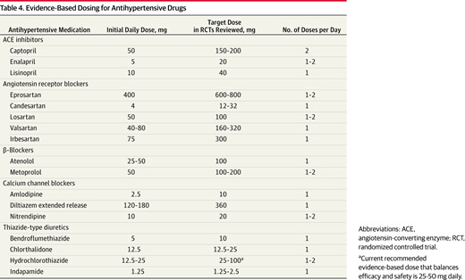
Hypertension
It’s important that individuals treated for hypertension are dosed appropriately to achieve the outcomes similar to the studies used for the guidelines:¹
Notes:
The JNC8 guidelines mention that it’s important for individuals treated for HTN to be dosed appropriately in order to achieve the outcomes similar to the studies used for the JNC8 guidelines. I listed their table here.

Slide 23
Hypertension
Recommendation 7: ¹
  In the general black population, including those with diabetes, initial antihypertensive treatment should include a thiazide-type diuretic or CCB.
    Side note: recommendations extrapolated from the ALLHAT trial reported in this patient population:
      Thiazide-type diuretics were more effective in improving cerebrovascular and heart failure outcomes than ACEI. ¹²
      There was a 51% higher rate of stroke with the initial use of ACEI compared to CCB, and ACEI were less effective in reducing BP. ¹²
Notes:
Grade C – No eligible trials were available for review that studied the use of CCB vs ACEI use in this population.

Slide 24
Hypertension
Recommendation 8: ¹
  In patients ≥ 18 years old with CKD and hypertension, BP pharmacotherapy should include an ACEI or ARB to improve kidney outcomes, regardless of race or diabetes status.
    Side note: What about a hypertensive black patient that has CKD?
      Kidneys trump race… Treat with ACEI or ARB first.

Slide 25
Hypertension
Recommendation 9:
  If goal BP is not attained within a month on initial therapy, increase dose of initial drug or add second drug. If goal BP is not attained with 2 drugs, add a 3rd.
  Do not use ACEI and ARB together in the same patient.
  If patients are not able to use medications in the suggested 4 drug classes, antihypertensives medications from other classes may be used.

Slide 26
Hypertension
¹⁶
Notes:
The American College of Cardiology (ACC) and the American Heart Association (AHA) have started to work on a new guideline for the management of hypertension, which will come out this year, and this will serve as an update to JNC7. In my opinion, I’m guessing that they will suggest the cut-off for systolic BP <150 to be 80 years old instead of 60 years old.
As clinicians, which guidelines do we use?

Slide 27
Hypertension
“…There is intense argument about the science, the analysis, the politics, and conflicts of interest in the writing of these guidelines. If experts who spend their careers studying hypertension cannot agree on the best management for hypertension, where does that leave practicing clinicians?” ¹³
“Understand that the evidence and guidelines will never be perfect. It’s so easy to forget that medicine is a science and an art. Strive to balance the scientific evidence and expert opinion with one’s own experience, never forgetting to include the patient in the conversation about what should be done.” ¹³
Notes:
In the end, this is not black and white…use your clinical judgment.

Slide 28
Hypertension
MT, a 59 year old Native American male is referred to the DSM clinic by his PCP for hypertension. He has hyperlipidemia, diabetes, chronic low back pain, BPH, is obese, smokes 1 ppd and drinks 1 pot of coffee per day. He works in construction, building homes. Because he travels a lot, he doesn’t exercise and doesn’t like to cook. He often eats at restaurants several times a day. He also salts his food. His blood pressure today is 165/86, which is normal for him. His BP meds are lisinopril 40mg daily, amlodipine 10mg daily, and terazosin 2mg QHS. He has no side effects and says he doesn’t care what his BP is or the potential long term effects that high BP could cause because he feels great.
What is his goal BP, according to JNC 8?
If you had to add or increase a hypertension medication, what would you do?
What approach would you use to get him to care about his hypertension?
Notes:
<140/90 (< 60 years old)
Lisinopril and amlodipine are already at target doses. Diuretic in BPH is not a good idea. Increase terazosin to 5mg at bedtime.
3. You’re going to tell him that he needs to work on lifestyle changes: quit smoking, stop drinking caffeine, stop salting food, start cooking for yourself, eat less, start exercising, etc. Right? No. Through motivational interviewing, I found out that his 10 year old autistic Grandson is important to him. So what I did was calculate his 10-year chance of having an MI, and it was 31%. And I asked him, “what do you think your Grandson would do if you died from a heart attack? And he broke down. His Grandson was his motivation.
Patient made lifestyle changes and we didn’t need to change his medications.

Slide 29
Hyperlipidemia
    2013 ACC/AHA Guideline on the Treatment of Blood Cholesterol to Reduce Atherosclerotic Cardiovascular Risk in Adults

Slide 30
Hyperlipidemia
Topic | ATP III | 2013 Cholesterol Guideline
Risk estimation | Framingham Risk Score determined 10-year risk of coronary heart disease | Pooled cohort equations estimate 10-year risk of heart disease and stroke
Target groups | High risk – CHD or CHD equivalents: LDL ≥100 Moderately high risk – ≥2 risk factors & FRS = 10-20%: LDL ≥130 Intermediate risk – ≥2 risk factors & FRS <10%: LDL ≥160 Low risk – 0-1 risk factor: LDL ≥190 | 4 primary statin benefit groups: -Clinical ASCVD -LDL >190 -Diabetics 40-75 years with LDL 70-189 w/o ASCVD -LDL 70-189 w/o DM or ASCVD and ASCVD risk ≥7.5%
Treatment goals | LDL is 1º target: -Very high risk (CHD + other defined risk factors): LDL <70 -High risk (CHD or equivalents (10-year risk >20%): LDL <100 -Multiple (≥2) risk factors (10-year risk ≤20%): LDL <130 -0-1 risk factor: LDL <160 Non-HDL is 2º target if TG ≥ 200: Non-HDL goal is LDL goal + 30 If TG ≥500, TG is 1º goal: Once TG <500, LDL becomes 1º goal | Use maximum tolerated statin intensity in those groups shown to benefit.
Therapy | Use LDL-lowering drugs; fibric acids or nicotinic acid can be added to LDL-lowering drugs when TG are high or HDL is low. | High intensity statin vs. moderate intensity statin; nonstatins may be used in high risk individuals if benefits outweigh the potential for adverse events.
ASCVD: atherosclerotic cardiovascular disease; ATP: Adult Treatment Panel; CHD: coronary heart disease; DM: diabetes mellitus;
FRS: Framingham Risk Score; HDL: high-density lipoprotein; LDL: low-density lipoprotein; TG: triglycerides ^{18,19}
Notes:
Again… going over the comparisons from the last cholesterol guidelines…

Slide 31
Hyperlipidemia
3 critical questions were identified and addressed to determine how to treat adults with hyperlipidemia:
What is the evidence for LDL and non-HDL goals for the secondary prevention of ASCVD?
What is the evidence for LDL and non-HDL goals for the primary prevention of ASCVD?
For primary and secondary prevention, what is the impact on lipid levels, effectiveness, and safety of specific cholesterol-modifying drugs used for lipid management in general and in selected subgroups?
  (ASCVD = coronary heart disease (CHD), peripheral artery disease (PAD), stroke, TIA)
Notes:
ASCVD = atherosclerotic cardiovascular disease
What is the evidence for LDL and non-HDL goals for primary and secondary prevention of ASCVD? What is the impact of cholesterol-modifying medications?

Slide 32
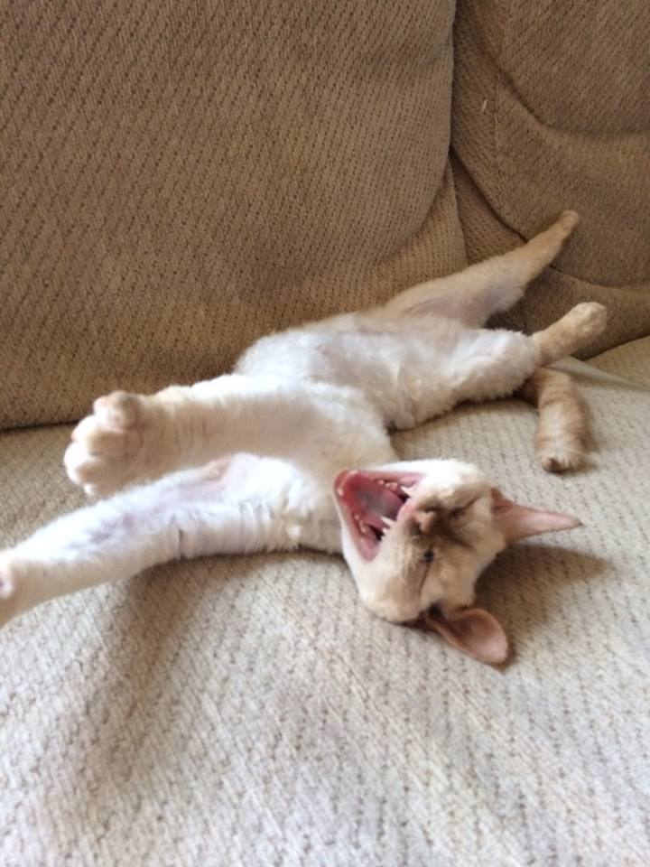


Hyperlipidemia
Recommendation 1: “Lifestyle modification (heart healthy diet, regular exercise, avoidance of tobacco products, and maintenance of a healthy weight) remains a critical component of health promotion and ASCVD risk reduction, both prior to and in concert with the use of cholesterol-lowering therapies.” ¹⁵
Notes:
Do any of you have that family member, friend, or patient that says, “I don’t need to watch what I eat…that’s why I take those cholesterol pills.”?

Slide 33
Hyperlipidemia
Recommendation 2: Four major statin benefit groups were identified. Individuals with:
  Clinical ASCVD (coronary heart disease (CHD), peripheral artery disease (PAD), stroke, TIA)
  LDL ≥ 190 mg/dL
  Diabetics (40-75 years old) with LDL of 70-189 (without clinical ASCVD)
  LDL of 70-189 and estimated 10-year ASCVD risk ≥ 7.5%

Slide 34
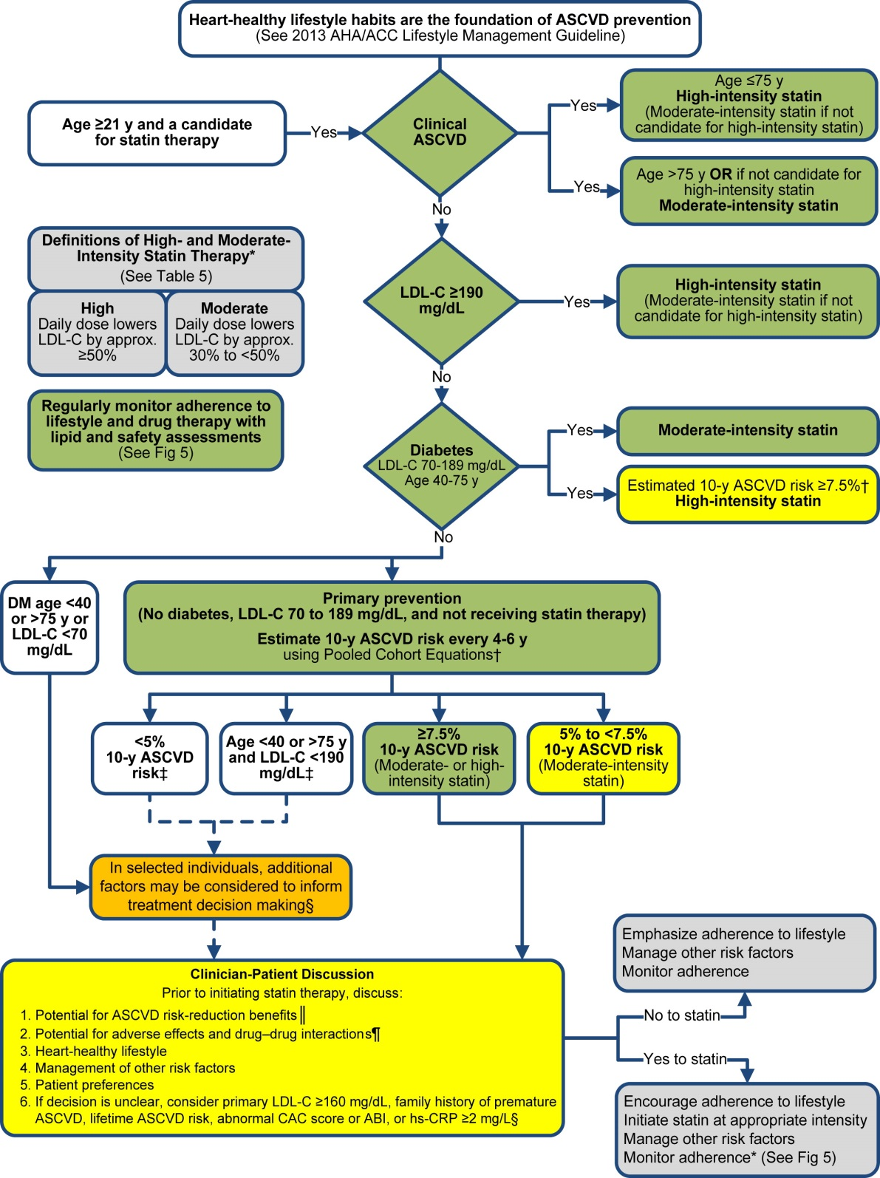
Notes:
I’m sure most of you have seen this algorithm for therapeutic management of hyperlipidemia. Notice that there are only recommendations for statin therapy, not other cholesterol medication classes.

Slide 35
Hyperlipidemia
High-Intensity Statin (↓ LDL by ≥50%) | Moderate-Intensity Statin (↓ LDL by 30%-<50%) | Low-Intensity Statin (↓ LDL by <30%)
Atorvastatin 40-80mg | Atorvastatin 10-20mg | Simvastatin 10 mg
Rosuvastatin 20-40mg | Rosuvastatin 5-10mg | Pravastatin 10–20mg
 | Simvastatin 20–40mg | Lovastatin 20mg
 | Pravastatin 40-80mg | Fluvastatin 20–40mg
 | Lovastatin 40mg | Pitavastatin 1mg
 | Fluvastatin XL 80mg
 | Fluvastatin 40mg bid
 | Pitavastatin 2–4mg
Notes:
I’ve listed the medications for high intensity, moderate intensity, and low intensity statins.

Slide 36
Hyperlipidemia
3/3/14: S.T. is an 80 year-old Native American woman who has:
  RA – MTX
  DMII – Levemir 15 units daily, Novolog 2-4 units with meals
  HTN – amlodipine 10mg daily, lisinopril 20mg BID, carvedilol 6.25mg BID
  Hyperlipidemia – gemfibrozil 600mg BID
  CABG in December
  The last cholesterol labs are as follows:
  3/7/13 - Direct LDL 107
  2/2/12 - LDL 74, TC 131, HDL 31, TG 128
How would you manage her hyperlipidemia?
Notes:
Here is our 80 year old hypertensive patient again.

Slide 37
Notes:
Because of her history of MI, ST is a candidate for a statin therapy, but at a moderate dose due to her age. Simvastatin and atorvastatin are on the formulary. Simvastatin interacts with her amlodipine, so atrovastatin 10mg daily was prescribed. Discontinue gemfibrozil. In her case, because of her history of ASCVD, her labs are irrelevant. Again, the goal is to use the highest effective statin dose.

Slide 38
Hyperlipidemia

Slide 39
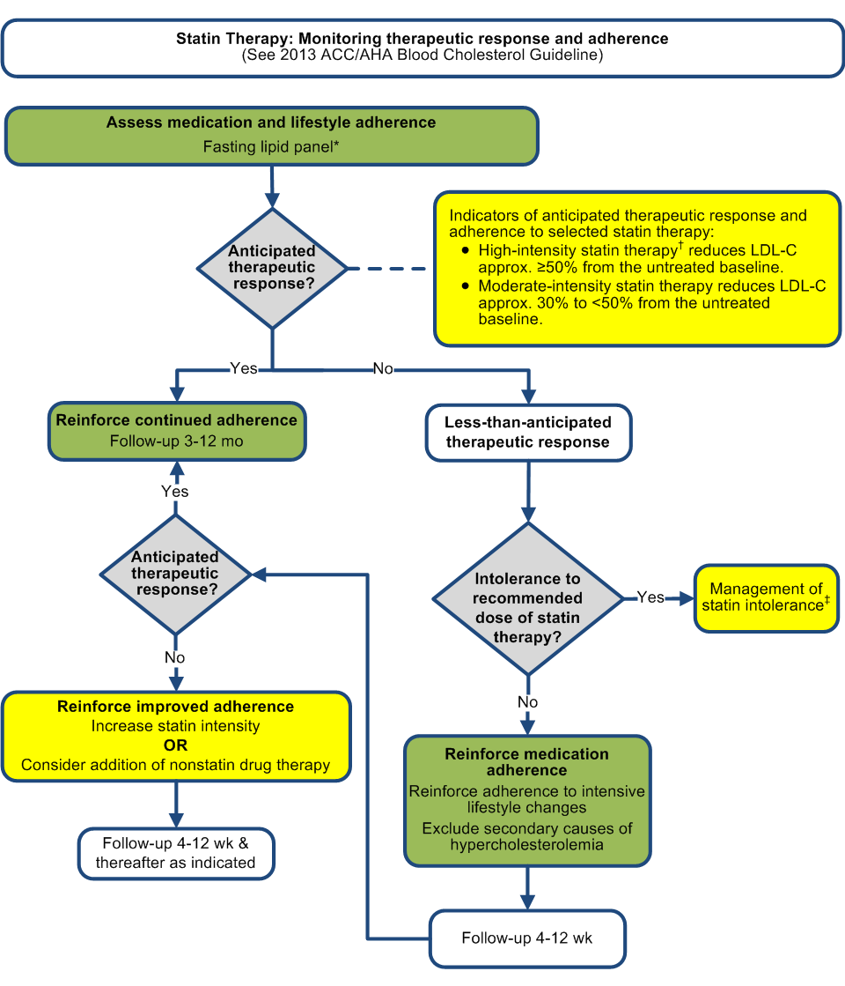
Notes:
After baseline fasting lipid panel, you want to follow up in 3-12 months. If the patients has not achieved the anticipated therapeutic response (for example, if someone is on a high-intensity statin, and their LDL has decreased by only 20% instead of ≥ 50%, you would want to check compliance and ask if the patient is experiencing any intolerances. If they are compliant, increase the statin intensity or consider adding a nonstatin drug.

Slide 40
Hyperlipidemia
Why the change from target LDL goals to the current guidelines?
  RCT show that ASCVD events are reduced by using the maximum tolerated statin intensity; use of LDL targets may result in under-treatment. ¹⁵
What about nonstatin medication?
  No data show that adding a nonstatin drug to high-intensity statin therapy will provide ASCVD risk reduction benefits with acceptable safety margins.
  If triglycerides are > 500, fenofibrate may be considered with a low- or moderate-intensity statin
What about medication safety?
  Do not initiate simvastatin 80mg
  Do not initiate gemfibrozil in patients on statin therapy
Notes:
Just like HTN guidelines, there are other competing recent releases of cholesterol guidelines out there, with the most recent being from the National Lipid Association, in which they kind of took elements from both ATP III and the updated 2013 guideline.

Slide 41
Hyperlipidemia
S.R. is a 40 year old Native American female that has DMII, hypertension, hyperlipidemia, and depression. She was seen in the ER for suicidal ideation and transferred to a psychiatric center for 4 weeks. She is being discharged today and you receive her discharge med list. You notice that the patient was prescribed simvastatin 40mg QHS 9 months ago, and according to her refill history, looks compliant. But the physician at the psychiatric center discontinued her simvastatin and prescribed niacin. The patient’s 10-year risk for an ASCVD event prior to starting simvastatin was 8.4%. Her last fasting lipid profile was drawn 9 months ago and is as follows:
TG 258, TC 234, HDL 59, LDL 123
You call the nurse to see why the statin was discontinued and why the patient was started on a medication that shows no benefit as far as ASCVD outcomes.
What intensity statin should the patient be taking?

Slide 42
No ASCVD
LDL is 123
Diabetic
LDL is 123
40 y.o. with 10-year
ASCVD risk of 8.4%
Notes:
No ASCVD, LDL is 123, she is diabetic, LDL is 123, and is 40 y.o. with ASCVD risk of 8.4%...High intensity statin.
So, I called and talked to the nurse at the psych center. A fasting lipid panel was drawn while the patient was inpatient and found that her TG’s were 612, so they wanted to prevent pancreatitis and started her on niacin. This is a tough one! She needs to be on a fibric acid because of her high TG’s, but also need to be on a high intensity statin. The guidelines suggest adding a fibric acid to a low or moderate intensity statin. What do you do? If I would have seen her in my DSM clinic, because of her age and because she was previously compliant with a moderate-intensity statin, I would put her on a high intensity statin, but probably atorvastatin 40mg instead of 80mg with fibric acid, and monitored her closely for side effects.

Slide 43
Hyperlipidemia
How is the 10-year ASCVD risk calculated?
  Pooled Cohort Risk Assessment Equations.
    Developed by one of the work groups to determine the first occurrence of nonfatal and fatal MI or stroke.
Controversy surrounding the Pooled Cohort Equations
  In patients with a lower predicted risk, overestimation of risk could be an issue
  This was acknowledged by the panel, which is why they chose >7.5%, rather than >5%, which was suggested by the clinical data, creating a buffer against potential overestimation of risk
  No risk assessment algorithm or calculator will ever be perfect for personalized medicine
Notes:
For example, men older than 66 and women older than 70 yo have a calculated 10-year risk > 7.5%, even with optimal risk factors. But, the guidelines point out that most ASCVD events occur after the age of 70, making these individuals a population with the greatest potential for absolute risk reduction. Use clinical judgment!
Good thing about the equation: Risk assessment tool that uses the best available data from a large population, including different races and both genders, with both stroke and heart attack as endpoints…not the case with Framingham.

Slide 44
Hyperlipidemia
AM is 61 yo Native American female who is referred to IPC clinic for hyperlipidemia. She has:
Hypothyroidism – levothyroxine 0.15mg daily
Hypertension – metoprolol 12.5mg BID
Hyperlipidemia – simvastatin 40mg QHS
MI four months ago - aspirin, clopidogrel, isosorbide SA, and nitro SL tabs were prescribed
Her last direct LDL was 269 four months ago. The patient seems upset during the visit and as med rec is performed, states she is not taking any of her medications and doesn’t want to take them, and can’t remember to take them anyway.
Are her hyperlipidemia medications appropriate?
How would you use health coaching to manage her hyperlipidemia?
Notes:
Patient should be taking high dose statin.
Patient is upset that she is always being told what to do…cardiologist, PCP, nursing, pharmacists, and family. It’s my life, my body, and people should not tell me what to do. I feel like a number and I’m scared of the medication side effects. No one listens to what I want or what I should do. It’s my life!
You are right…no one has the right to tell you what to do. If you don’t want to take your medications, then you don’t have to. So, when it comes to your health, what are your goals? Do you even have any goals? “I don’t want to have another heart attack.” Let’s go over your medications and why they were prescribed, and you can decide if you want to take them. When I was done, I asked her what her plans were. She decided that she wanted to take all of them.
Pill minder given to patient. Simvastatin at bedtime was changed to high-intensity atorvastatin, immediate release metoprolol was changed to extended release metoprolol to help decrease pill burden and coordinate medication administration times.
I agreed to call her in a month to see how she is doing, if she’s experiencing any side effects, and if she needs refills. I have been seeing her for just over a year, and I still call her monthly. She is compliant with her medications and always appreciates the phone calls.

Slide 45

Questions?
Christel.Svingen@ihs.gov

Slide 46
References
James PA, Oparil S, Carter BL, et al. 2014 Evidence-Based Guideline for the Management of High blood Pressure in Adults: Report From the Panel Members Appointed to the Eight Joint National Committee (JNC-8) JAMA. 2013 Dec 8.
Domino FJ. Despite Controversy, JNC 8 Guideline Provides Much-needed Standards for Hypertension Management. Healthcare Professionals Network. 2014 Jan 1.
Mitka M. IOM report: Evidence fails to support guidelines for dietary salt reduction. JAMA. 2013 Jun 26
Esposito K, Ceriello A, Genovese S, et al. Cardiovascular Guidelines: Separate Career May Help Attenuate Controversy. Cardiovasc Diabetol. 2014.
CushmanWC, Evans GW, Byington RP, et al. ACCORD Study Group. Effects of intensive blood-pressure control in type 2 diabetes mellitus. N Engl J Med. 2010;362(17):1575-1585.
Hansson L, Zanchetti A, Carruthers SG, et al; HOT Study Group. Effects of intensive blood-pressure lowering and low-dose aspirin in patients with hypertension: principal results of the Hypertension Optimal Treatment (HOT) randomised trial. Lancet. 1998;351(9118):1755-1762.
Patel A, MacMahon S, Chalmers J, et al; ADVANCE Collaborative Group. Effects of a fixed combination of perindopril and indapamide on macrovascular and microvascular outcomes in patients with type 2 diabetes mellitus (the ADVANCE trial): a randomised controlled trial. Lancet. 2007;370(9590):829-840.
UK Prospective Diabetes Study Group. Tight blood pressure control and risk of macrovascular and microvascular complications in type 2 diabetes: UKPDS 38. BMJ. 1998;317(7160):703-713.
New Blood Pressure Guidelines Draw Fire; Dissenting medical experts from panel warn that new rules could endanger some people. http://www.aarp.org/health/conditions-treatments/info-2014/new-blood-pressure-guidelines-raise-controversy.2.html. Obtained from the internet on 4/6/15.
Dahlof B, Devereux RB, Kjeldsen SE, et al; LIFE Study Group. Cardiovascular morbidity and mortality in the Losartan Intervention For Endpoint reduction in hypertension study (LIFE): a randomised trial against atenolol. Lancet. 2002;359(9311):995-1003.
Antihypertensive and Lipid-Lowering Treatment to Prevent Heart Attack Trial Collaborative Research Group. Diuretic versus alpha-blocker as first-step antihypertensive therapy: final results from the Antihypertensive and Lipid-Lowering Treatment to Prevent Heart Attack Trial (ALLHAT). Hypertension. 2003;42(3):239-246.

Slide 47
References
ALLHAT Officers and Coordinators for the ALLHAT Collaborative Research Group. The Antihypertensive and Lipid-Lowering Treatment to Prevent Heart Attack Trial: major outcomes in high-risk hypertensive patients randomized to angiotensin-converting enzyme inhibitor or calcium channel blocker vs diuretic. JAMA. 2002;288(23):2981-2997.
Gianikos D. Hyper Tension: the JNC 8 Controversy. http://www.consultant360.com/blog/dean-gianakos-md-facp/hyper-tension-jnc-8-controversy. Obtained from the internet on 4/9/15.
Wright JT, Fine LJ, Lackland DT, et al. Evidence Supporting a Systolic Blood Pressure Goal of Less Than 150 mm Hg in Patients Aged 60 Years or Older: The Minority View. Ann Intern Med. 2014;160(7):499-503.
Goff DC Jr, Lloyd-Jones DM, Bennett G, et al. 2013 ACC/AHA guideline on the assessment of cardiovascular risk: a report of the American College of Cardiology/American Heart Association Task Force on Practice Guidelines. Circulation. 2014;129(25 suppl 2):S49–S73.
Hannings A, Firm AL, Bertrand CA, Galdo JA. Hypertension 101: A Review of JNC 8. U.S. Pharmacist. 2015 Feb 28.
Properties of Statins. UpToDate. Obtained from the internet on 3/6/15.
Jackevicius CA, How Do the 2013 Cholesterol Guidelines Compare With Previous Cholesterol Guidelines Reports? Circ Cardiovasc Qual Outcomes. 2014 Mar;7(2):306-10.
The Essential Guide to Health Coaching. Webmdhealthservices.com Obtained from the internet on 3/15/15.
Wellcoaches Trainee Handbook; Procedures for Wellcoaching Health and Wellness Coach Training Program. Wellcoaches School of Coaching. 2013
Health Coaching. Wikipedia. Obtained from the internet on 3/15/15.

