Slide 1
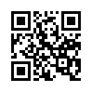
Pharmacy Diversion Awareness Conference
hosted by the
Drug Enforcement Administration
Designed for Pharmacists, Pharmacy Technicians, and Loss Prevention Personnel
October 2, 2016
Location:
Holiday Inn Fargo
3803 13th Avenue South
Fargo, North Dakota 58103
Time: Check-in: 7:00am – 8:00am
Conference: 8:30am – 5:00pm
Complete conference information and registration is
available at www.DEAdiversion.usdoj.gov
Continuing Education Credits Available for Pharmacists and Pharmacy Technicians

